Slide 1
Animal Habitats
Mary Elizabeth Williams
IDT 3600: Technology in Education
April 10, 2013

Slide 2
Content Area: Science Grade Level: Second Grade Summary: The purpose of this PowerPoint is to help students understand the different types of habitats that animals occupy, and know how to categorize animals correctly. Learning Objective: Students will learn the differences in animal habitats and be able to correctly label each animals habitat with 100% accuracy. Content Standard: GLE 0207.2.1 Investigate the habitats of different kinds of local plants and animals. Accomplishment: 0207.2.1 Draw or use pictures of a local environment to label the plants and animals.

Slide 3
What exactly is a habitat?
A habitat describes where an animal or plant lives or grows.
A habitat can also be known as a biome.
Habitats exist all around the world!
There are four main habitats.

Slide 4
The Four Main Habitats
The Rainforest
Grasslands
The Desert
Tundra

Slide 5
The Rainforest
Many different types of animals are a part of the rainforest habitat.
Many countries have rainforests in them.
South America has the largest Rainforest.
The Amazon Rainforest is the largest rainforest in the world.

Slide 6
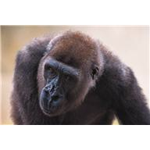
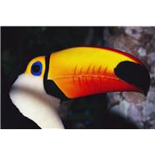
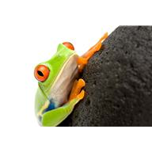
Animals that Live in the Rainforest
Some of the animals include:
*Toucan
*Boa Constrictor
*Red-Eyed Tree Frog
*Gorilla
*Panther Chameleon
http://kids.mongabay.com/elementary/201.html

Slide 7
A Grassland is an area of land that is full of plants, such as grasses and shrubs.
The
Grasslands
Some of the animals that live here include:
*Zebras
*Lion
*Prairie Dog
*Warthog
http://www.ducksters.com/science/ecosystems/grasslands_biome.php

Slide 8
The Tundra
The Tundra is an area of land that is very cold. All of the animals that live in this area must have very thick fur in order to survive.
Some of the Animals that live here include:
*Caribou
*Arctic Fox
*Polar Bear
*Snowy Owl

Slide 9
The Desert
The desert habitat is very dry and does not receive large amounts of rain. The animals that live there must be very adaptable to these conditions.
Some of the animals that live here include:
*Bark Scorpion
*Texas Horned Lizard
*Desert Toad

Slide 10
What is this animal’s habitat?

Slide 11
Show what you know!
Now that we have discussed different types of habitats that animals live in, let’s show off how much we have learned!
We will take the quiz below as a class and help each other continue to learn about places that animals live. This is a game, but remember, always raise your hand!
http://www.scholastic.com/magicschoolbus/games/habitat/index.htm

Slide 12
One Final Question…
Which of the four habitats we discussed today is your favorite, and why did you choose this one?

Slide 13
Conclusion
In this lesson, we learned that animals have different habitats they live in. The world is filled with different habitats and some of them are just right outside our window. We can now distinguish different habitats from one another and give examples of animals that live in each one.

